Slide 1
PHISHING ATTACKS
- By Pandya Dhara

Slide 2
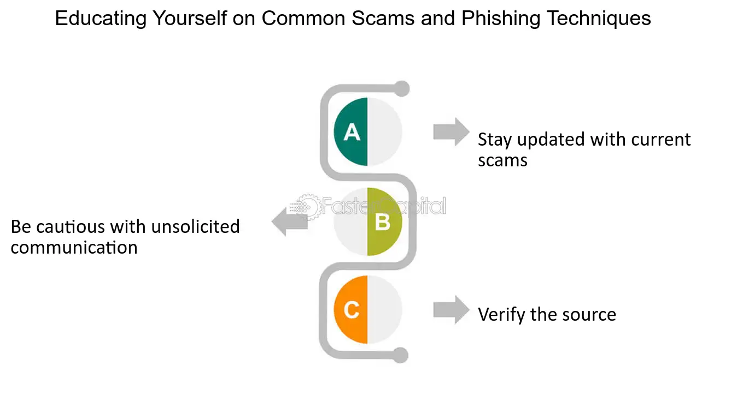
Familiarize yourself with phishing attacks Phishing is one of the most popular and dangerous cybercrimes; attackers steal victims' personal or financial information through this method and use it illegally. Through phishing, cybercriminals can get access to sensitive and confidential information of an individual or an organization.
Important phishing statistics for 2024 According to recently published Email Security Risk Report 2024, the top three most common phishing attack types are malicious URLS, attacks sent from compromised trusted third-party accounts and malware or ransomware.

Slide 3
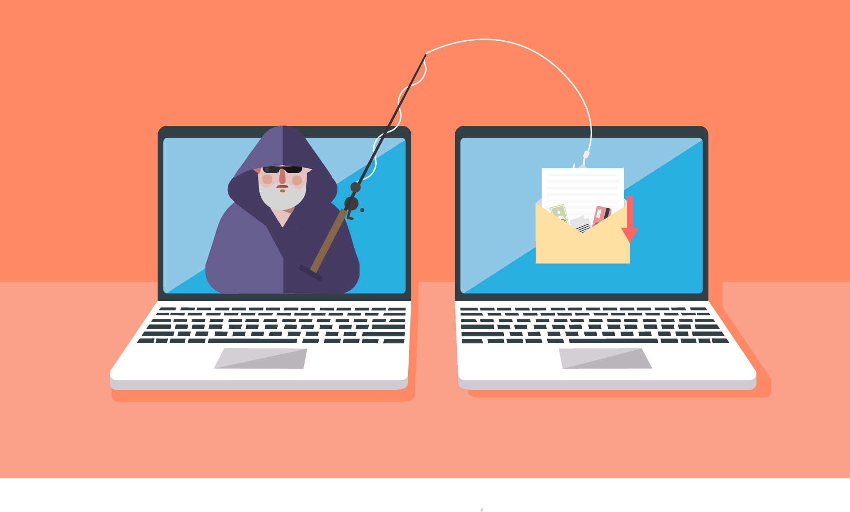
What is phishing?
Phishing is a cybercrime in which a target or targets are contacted by email, telephone or text message by someone posing as a legitimate institution to lure individuals into providing sensitive data such as personally identifiable information, banking and credit card details, and passwords.
The information is then used to access important accounts and can result in identity theft and financial loss.

Slide 4
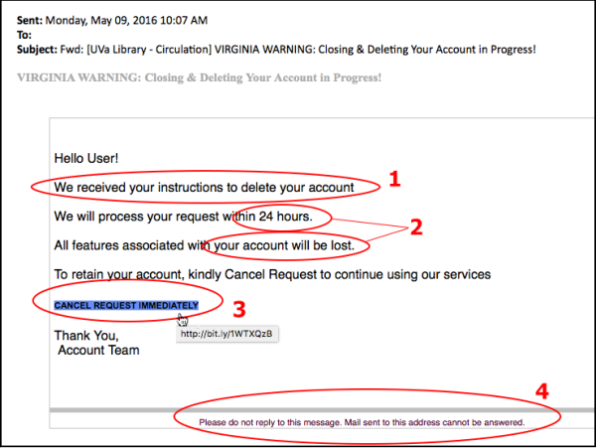
Phishing Examples
c

Slide 5
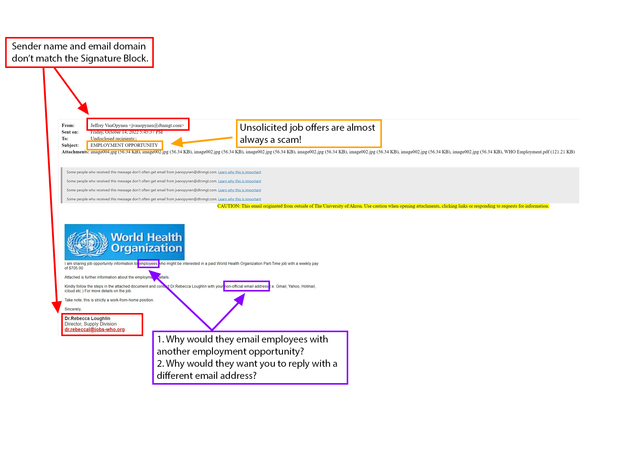
Phishing Examples

Slide 6
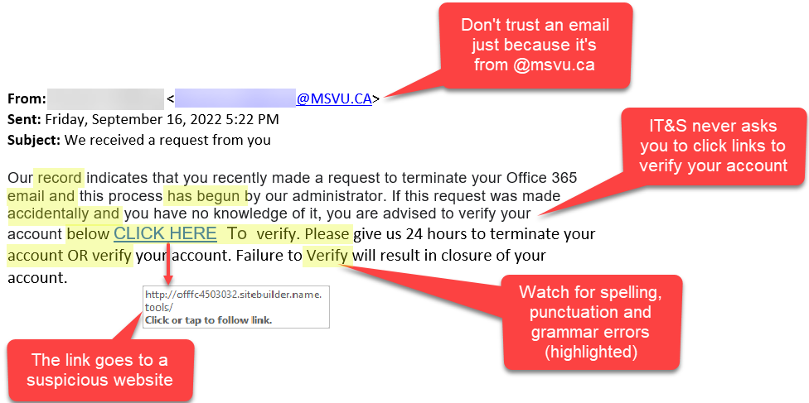
Phishing Examples

Slide 7
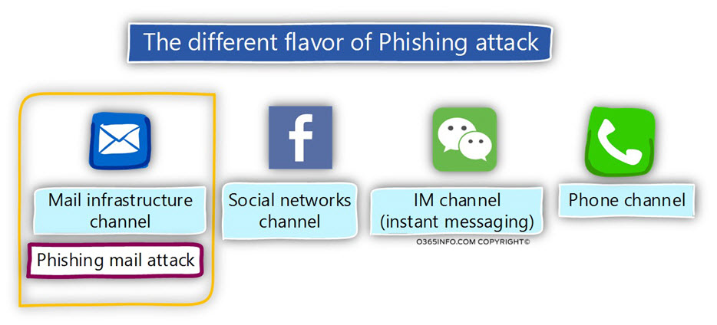
The Different Flavor of Phishing Attacks

Slide 8
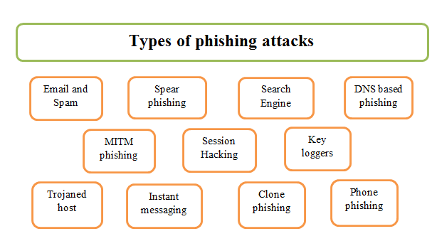
Types of Phishing Attacks

Slide 9
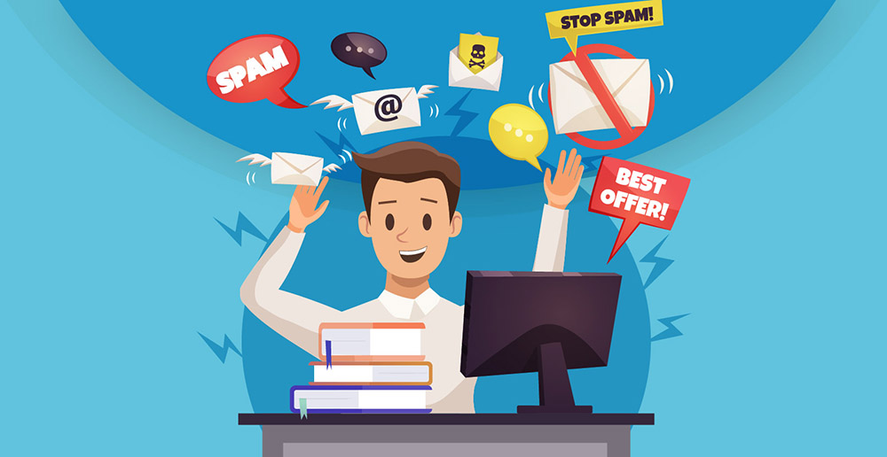
Email and spam
Spam is unsolicited email, instant messages, or social media messages. These messages are fairly easy to spot and can be damaging if you open or respond. Phishing is an email sent from an Internet criminal disguised as an email from a legitimate, trustworthy source.

Slide 10
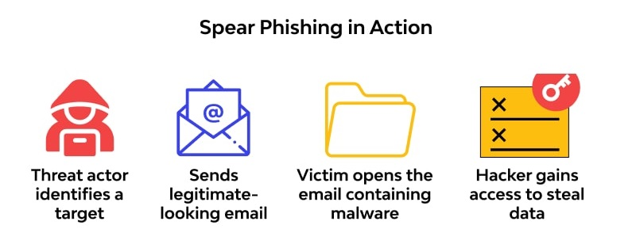
Spear Phishing
Spear-phishing is a type of phishing attack that targets specific individuals or organizations typically through malicious emails. The goal of spear phishing is to steal sensitive information such as login credentials or infect the targets' device with malware.

Slide 11
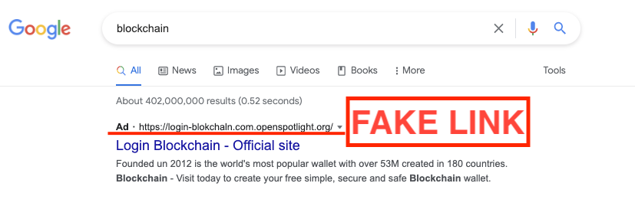
Search Engine Phishing
Search engine phishing, also known as SEO poisoning or SEO Trojans, is where hackers work to become the top hit on a search using a search engine. Clicking on their link displayed within the search engine directs you to the hacker's website.

Slide 12
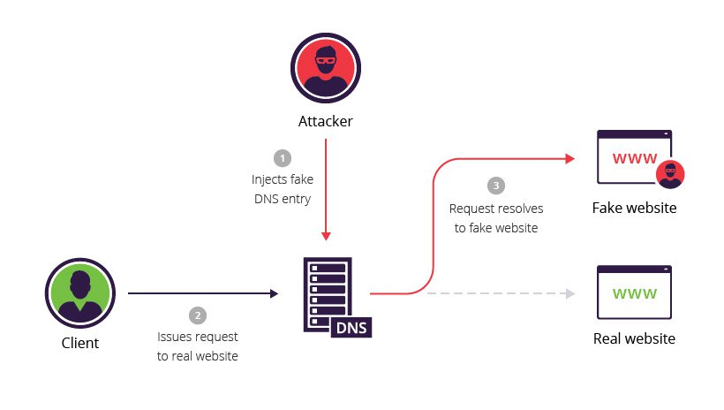
DNS based Phishing
DNS-based phishing is used here to refer generally to any form of phishing that interferes with the integrity of the lookup process for a domain name. This includes hosts file poisoning, even though the hosts file is not properly part of the Domain Name System.

Slide 13
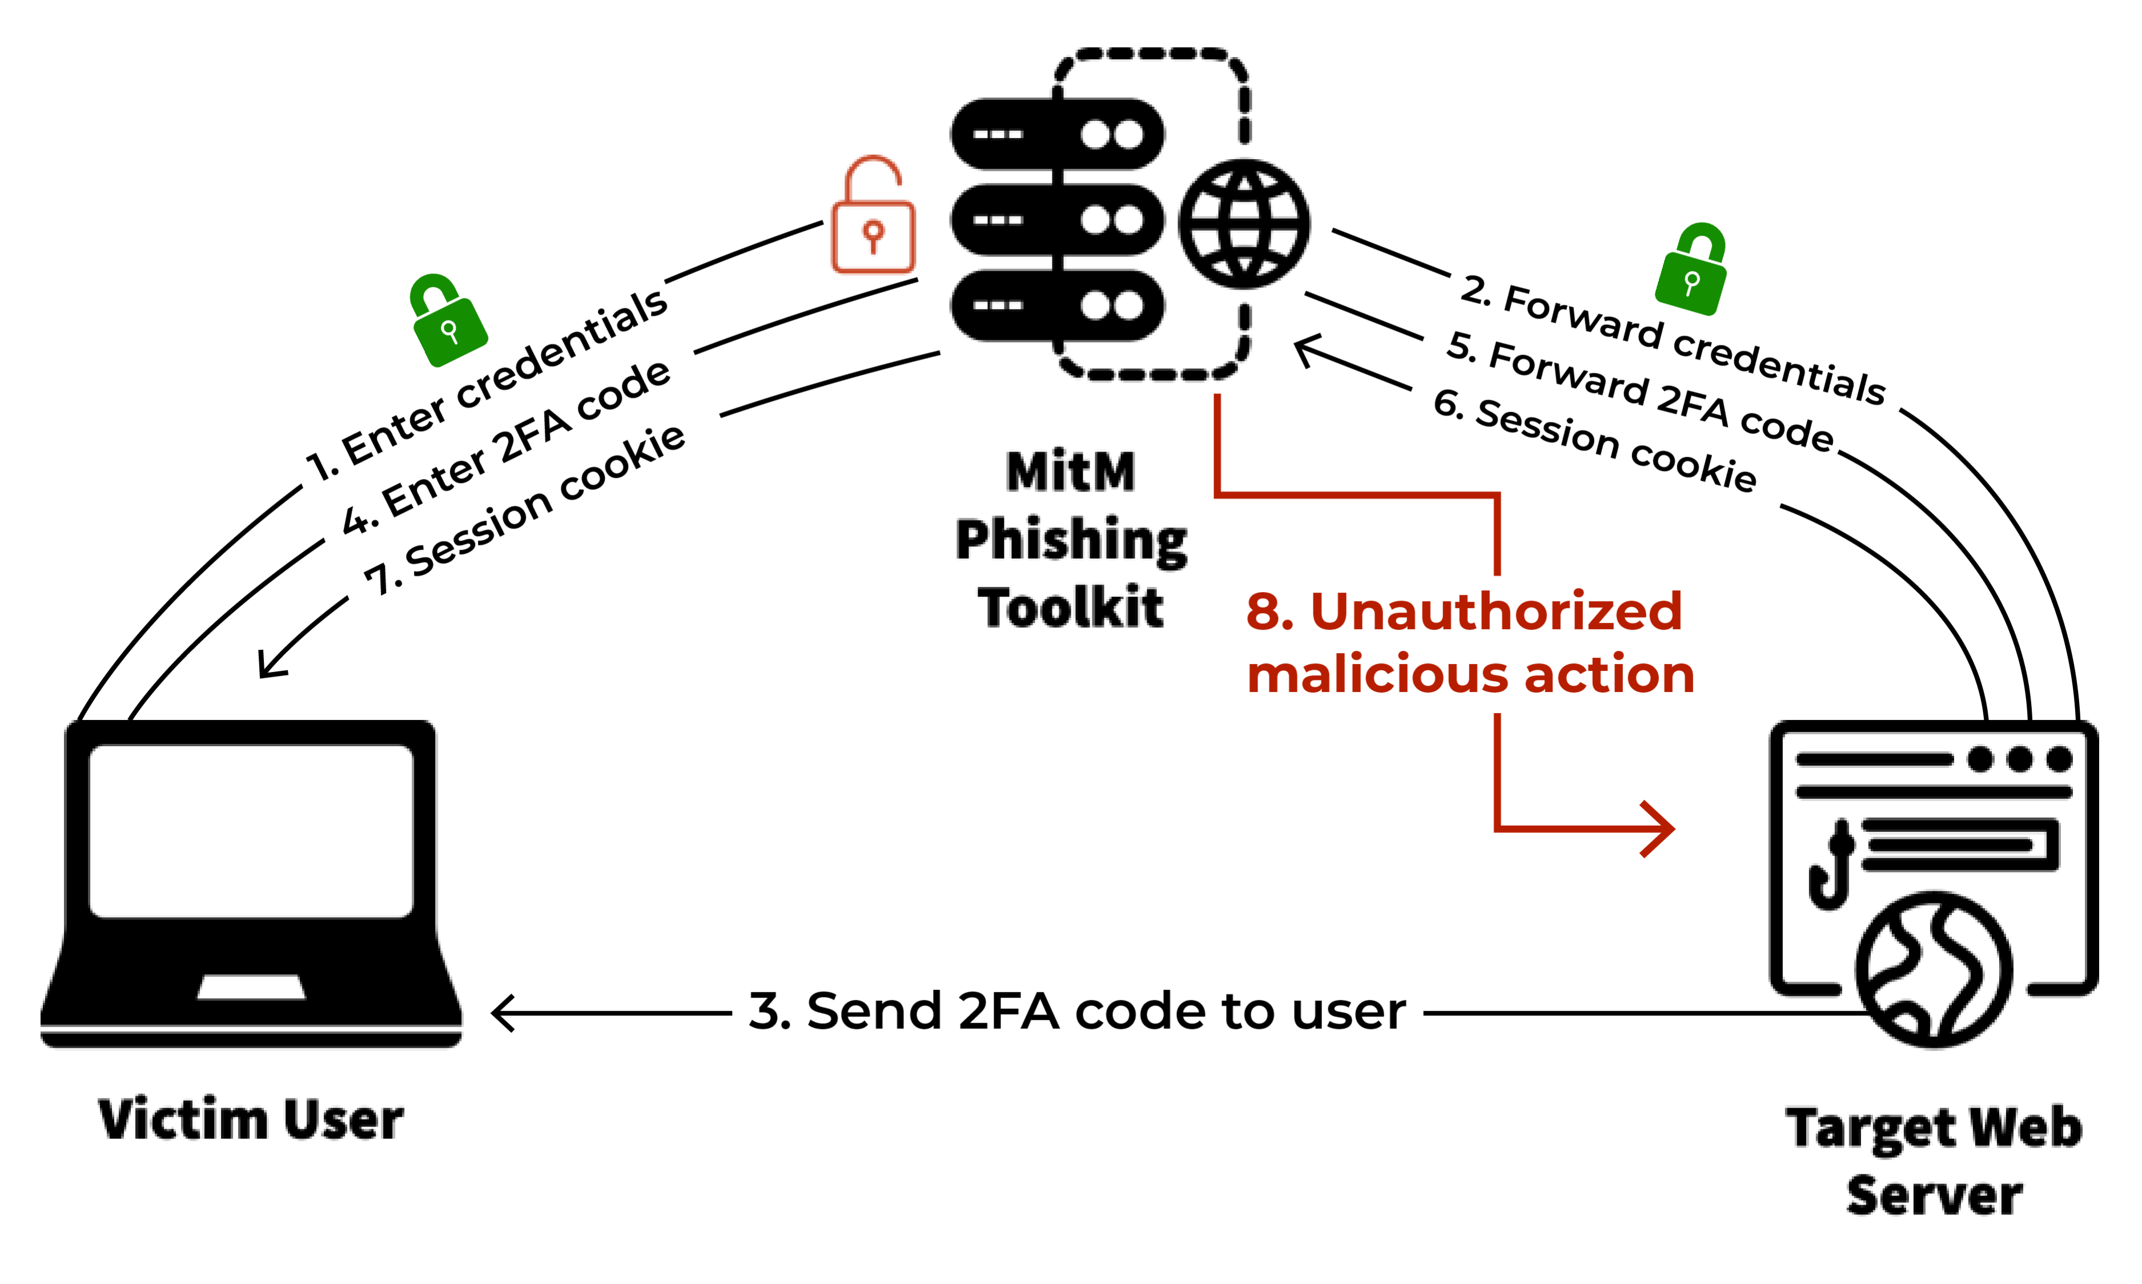
MITM Phishing
A man in the middle (MITM) attack is a general term for when a perpetrator positions himself in a conversation between a user and an application—either to eavesdrop or to impersonate one of the parties, making it appear as if a normal exchange of information is underway.

Slide 14
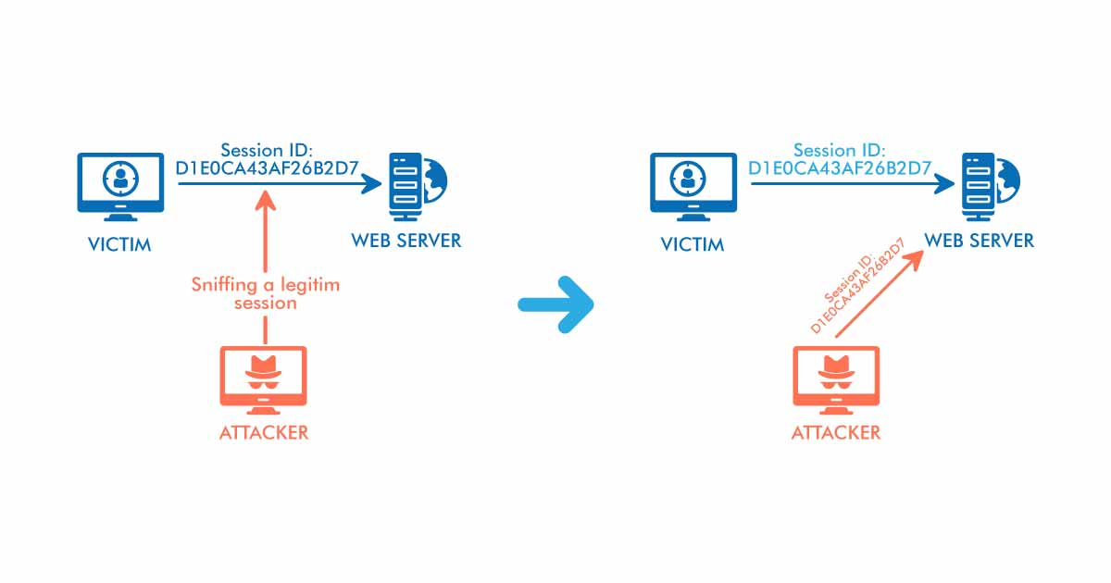
Session Hacking
Session hijacking allows attackers to access confidential information such as passwords, credit card numbers, Aadhar numbers, etc.

Slide 15
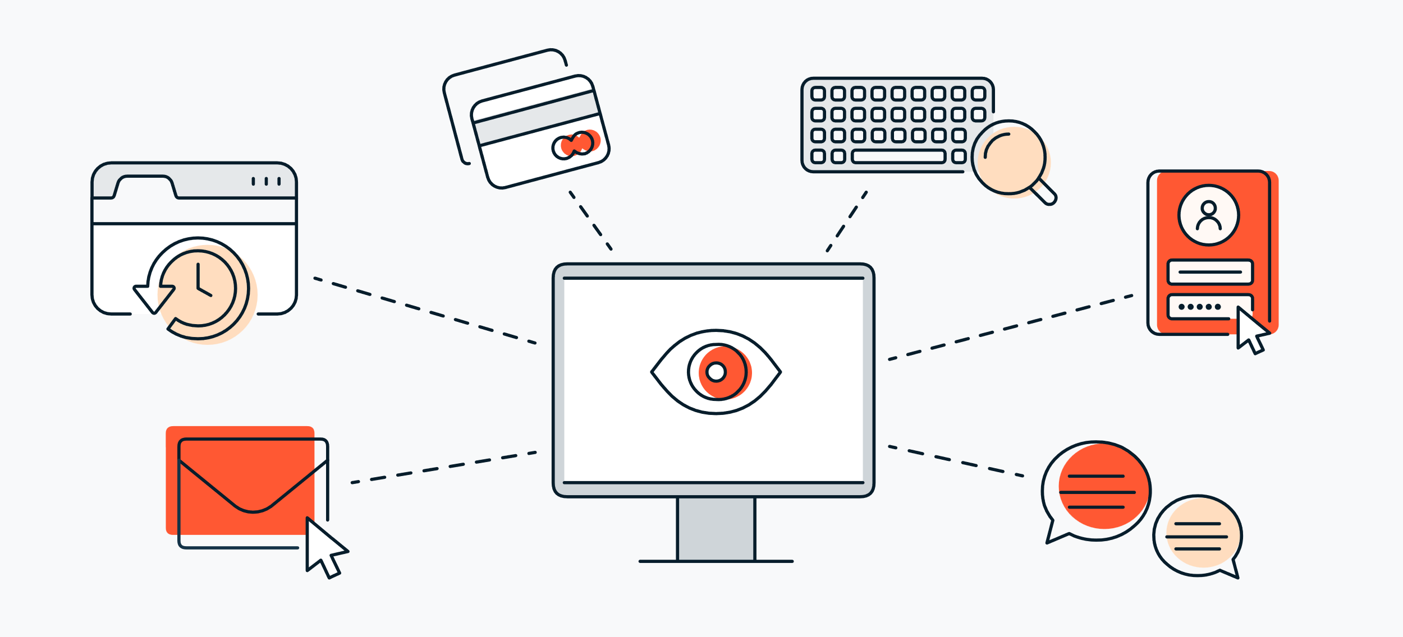
Key Loggers
When used for criminal purposes, keyloggers serve as malicious spyware meant to your capture sensitive information. Keyloggers record data like passwords or financial information, which is then sent to third-parties for criminal exploitation.

Slide 16
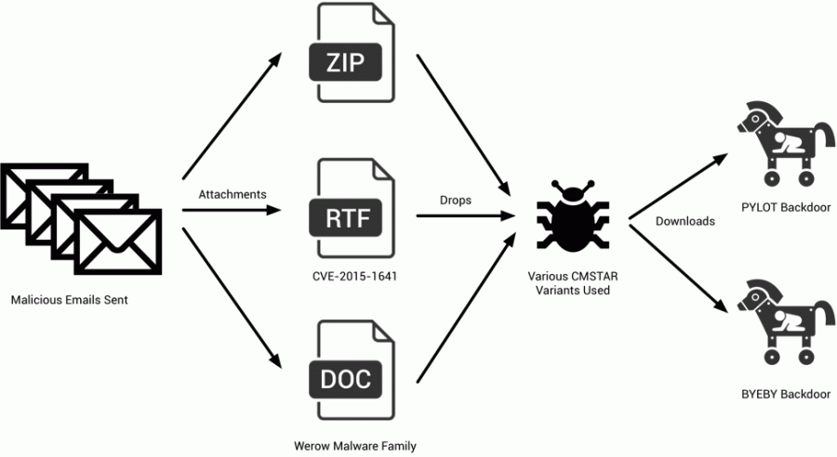
Trojaned Host
Trojan is any computer program that tricks the user into thinking they have received legitimate software when in fact the software is compromised with malware.

Slide 17
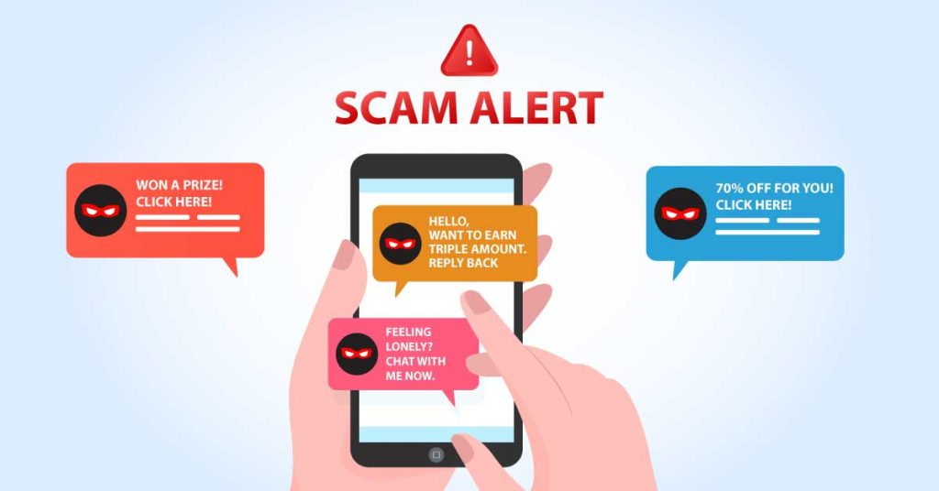
Instant Messaging
Smishing is a social engineering attack that uses fake mobile text messages to trick people into downloading malware, sharing sensitive information or sending money to cybercriminals. The term “smishing” is a combination of “SMS”—or “short message service,” the technology behind text messages—and “phishing.

Slide 18
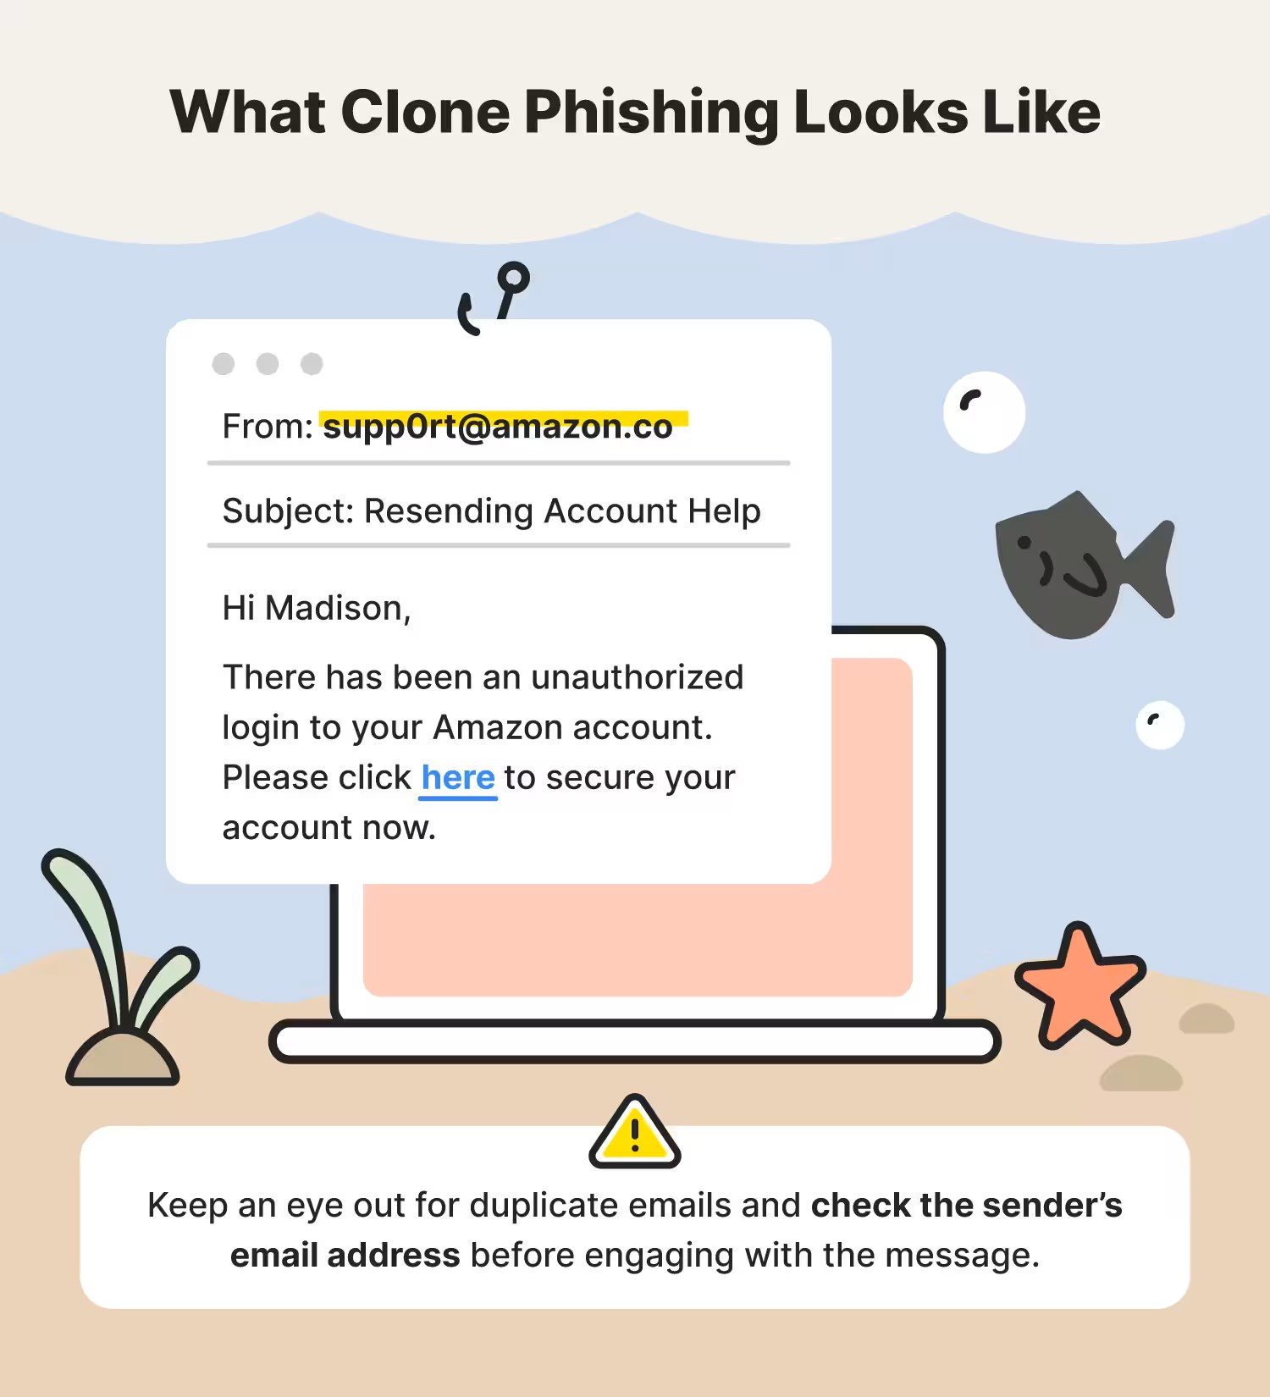
Clone Phishing
Clone phishing is a type of phishing attack where attackers aim to impersonate a trusted well-known company or entity by cloning their official website or emails. For example, many financial institutions, such as PayPal, use template emails to communicate with customers.

Slide 19
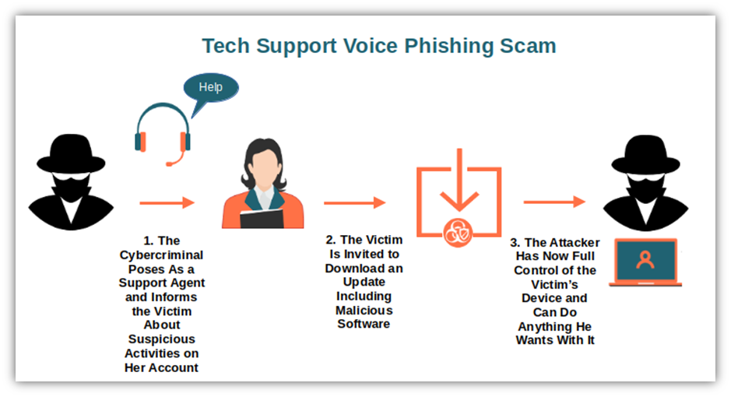
Phone Phishing
Vishing, short for voice phishing, refers to fraudulent phone calls or voice messages designed to trick victims into providing sensitive information, like login credentials, credit card numbers, or bank details.

Slide 20
Learn to spot Phishing Attacks
Urgent action demands.
Poor grammar and spelling errors.
An unfamiliar greeting or salutation.
Requests for login credentials, payment information or sensitive data.
Offers that are too good to be true.
Suspicious or unsolicited attachments.
Inconsistencies in email addresses, links and domain names.

Slide 21
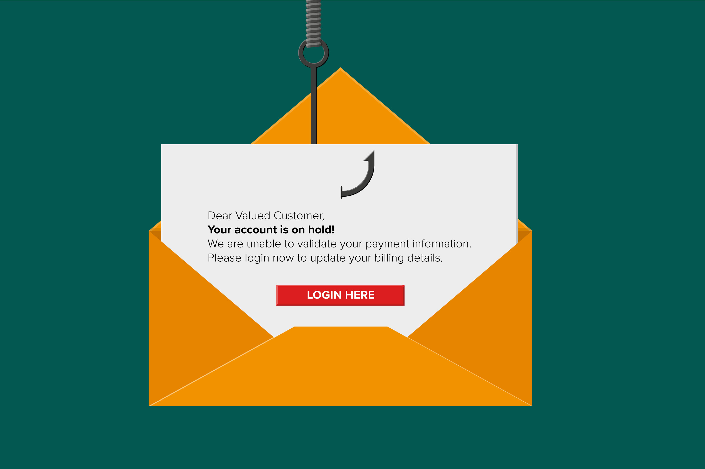
Learn to spot phishing emails
How to Spot Email Phishing with these 7 Tips :
Emails Demanding Urgent Action
Emails with Bad Grammar and Spelling Mistakes
Emails with an Unfamiliar Greeting or Salutation
Inconsistencies in Email Addresses, Links & Domain Names
Suspicious Attachments
Emails Requesting Login Credentials, Payment Information or Sensitive Data
Too Good to Be True Emails

Slide 22
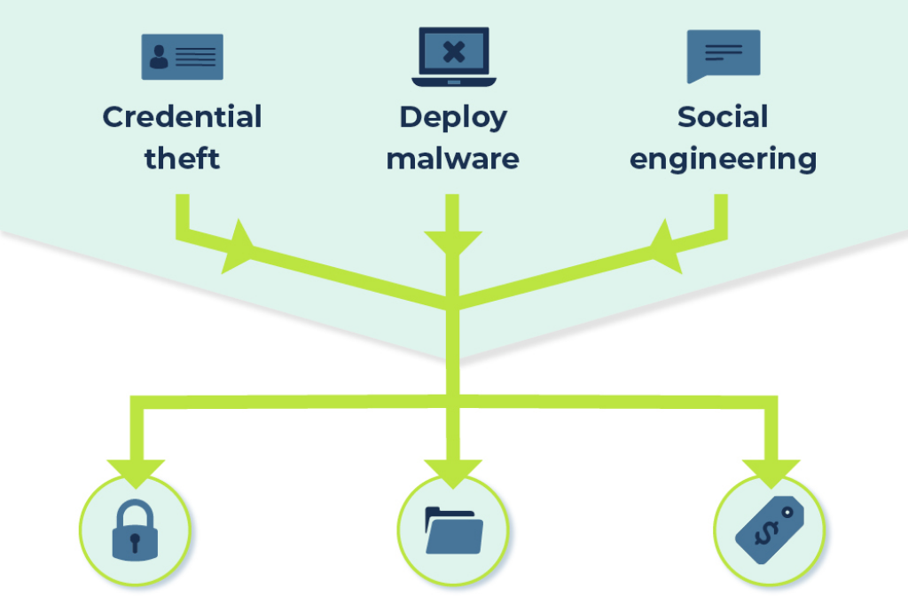
Impacts Of Phishing Attack
Credential theft may lead to major business disruption
Installing malware may lead to extortion
Social engineering may lead to monetary theft
Identity theft

Slide 23
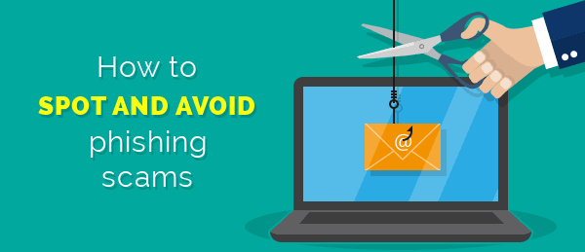
How do we stop getting phished?
10 Ways To Avoid Phishing Scams :
Keep Informed About Phishing Techniques
Think Before You Click!
Install an Anti-Phishing Toolbar
Check Your Online Accounts Regularly
Verify a Site’s Security

Slide 24
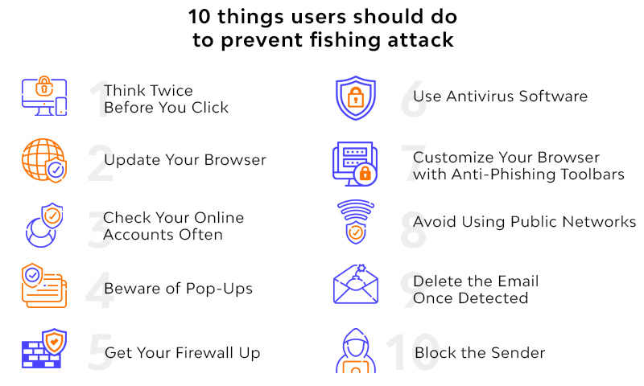
How do we stop getting phished?
Keep Your Browser Up to Date
Use Firewalls
Be Wary of Pop-Ups
Never Give Out Personal Information
Use Antivirus Software

Slide 25
Causes of Phishing Attacks:
Email is widespread - users with little to no cyber security awareness will use email and they’re easy to target
It’s an easy and simple method of targeting - as it doesn’t require technical skills, criminals don’t need to hack into systems or work out a password to succeed. Once the email has been sent, all they need to do is wait for replies, clicks, downloads of attachments - their main job is purely to only send the email itself then access networks through the malware
Fewer complications - they don’t need to bypass strict security protocols
Potential for wide net - phishing can lend itself to targeted attacks (spear phishing) or non-targeted, wide net attacks to gain as many footholds as possible
Versatile technique with many variants - phishing, spear phishing, internal spear-phishing and these can be used to deliver various types of malicious code like ransomware

Slide 26
Conclusion
Phishing is a form of scam in which an attacker poses as a legitimate entity or person via email or other forms of communication. Phishing emails are frequently used by attackers to distribute malicious links or attachments that can perform a variety of functions.

Slide 27
reference
www.google.com
www.Wikipedia.com
www.studymafia.org
www.phishing.org
www.cloudflare.com

Slide 28


